Slide 1
Lecture 11
Network Layer (3/3)
Routing Protocols
CSIM603154 - Jaringan Komunikasi Data
Fakultas Ilmu Komputer UI
3-<number>

Slide 2
Lecture 11: Roadmap
4.6 Routing in the Internet
  RIP
  OSPF
  BGP
Network Layer
4-<number>

Slide 3
Intra-AS Routing
also known as interior gateway protocols (IGP)
most common intra-AS routing protocols:
  RIP: Routing Information Protocol
  OSPF: Open Shortest Path First
  IGRP: Interior Gateway Routing Protocol (Cisco proprietary)
Network Layer
4-<number>

Slide 4
RIP ( Routing Information Protocol)
included in BSD-UNIX distribution in 1982
distance vector algorithm (Decentralized)
  distance metric: # hops (max = 15 hops), each link has cost 1
  DVs exchanged with neighbors every 30 sec in response message (aka advertisement)
  each advertisement: list of up to 25 destination subnets (in IP addressing sense)
from router A to destination subnets:
u
v
subnet hops
u 1
v 2
w 2
x 3
y 3
z 2
A
B
w
x
z
C
D
y
Network Layer
4-<number>

Slide 5
RIP: example
z
w
x
y
A
D
B
C
routing table in router D
destination subnet next router # hops to dest
w A 2
y B 2
z B 7
x -- 1
…. …. ....
Network Layer
4-<number>

Slide 6
RIP: example
A-to-D advertisement
dest next hops
w - 1
x - 1
z C 4
…. … ...
z
w
x
y
A
D
B
C
routing table in router D
destination subnet next router # hops to dest
w A 2
y B 2
z B 7
x -- 1
…. …. ....
A
5
Network Layer
4-<number>

Slide 7
RIP: link failure, recovery
if no advertisement heard after 180 sec --> neighbor/link declared dead
  routes via neighbor invalidated
  new advertisements sent to neighbors
  neighbors in turn send out new advertisements (if tables changed)
  link failure info quickly (?) propagates to entire net
Network Layer
4-<number>

Slide 8
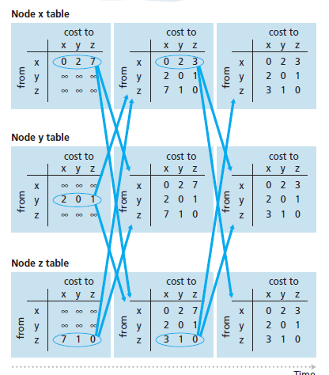
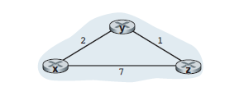

RIP (Example)
Network Layer
4-<number>

Slide 9
Lecture 11: Roadmap
4.6 Routing in the Internet
  RIP
  OSPF
  BGP
Network Layer
4-<number>

Slide 10
OSPF (Open Shortest Path First)
“open”: publicly available
uses link state algorithm (Centralized)
  LS packet dissemination
  topology map at each node
  route computation using Dijkstra’s algorithm
OSPF advertisement carries one entry per neighbor
advertisements flooded to entire AS
  carried in OSPF messages directly over IP (rather than TCP or UDP
Network Layer
4-<number>

Slide 11
Hierarchical OSPF
boundary router
backbone router
backbone
area
border
routers
area 3
internal
routers
area 1
area 2
Network Layer
4-<number>

Slide 12
Hierarchical OSPF
two-level hierarchy: local area, backbone.
  link-state advertisements only in area
  each nodes has detailed area topology; only know direction (shortest path) to nets in other areas.
area border routers: “summarize” distances to nets in own area, advertise to other Area Border routers.
backbone routers: run OSPF routing limited to backbone.
boundary routers: connect to other AS’s.
Network Layer
4-<number>

Slide 13

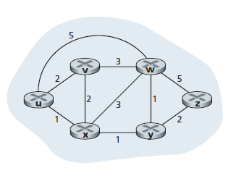
OSPF Example (LS)
Network Layer
4-<number>

Slide 14
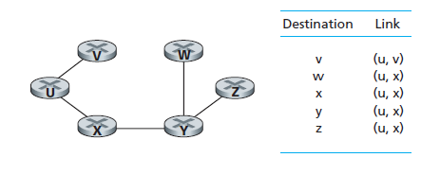
OSPF Example (LS)
Network Layer
4-<number>

Slide 15
Lecture 11: Roadmap
4.6 Routing in the Internet
  RIP
  OSPF
  BGP
Network Layer
4-<number>

Slide 16
Internet inter-AS routing: BGP
BGP (Border Gateway Protocol): the de facto inter-domain routing protocol
  “glue that holds the Internet together”
BGP provides each AS a means to:
  eBGP: obtain subnet reachability information from neighboring ASs.
  iBGP: propagate reachability information to all AS-internal routers.
  determine “good” routes to other networks based on reachability information and policy.
allows subnet to advertise its existence to rest of Internet: “I am here”
Network Layer
4-<number>

Slide 17
BGP basics
BGP session: two BGP routers (“peers”) exchange BGP messages:
  advertising paths to different destination network prefixes (“path vector” protocol)
  exchanged over semi-permanent TCP connections
when AS3 advertises a prefix to AS1:
  AS3 promises it will forward datagrams towards that prefix
  AS3 can aggregate prefixes in its advertisement
3c
3a
BGP
message
3b
AS3
2c
other
networks
1c
2a
other
networks
1a
2b
1b
AS2
AS1
1d
Network Layer
4-<number>

Slide 18
BGP basics: distributing path information
using eBGP session between 3a and 1c, AS3 sends prefix reachability info to AS1.
  1c can then use iBGP do distribute new prefix info to all routers in AS1
  1b can then re-advertise new reachability info to AS2 over 1b-to-2a eBGP session
when router learns of new prefix, it creates entry for prefix in its forwarding table.
eBGP session
3a
3b
iBGP session
AS3
2c
other
networks
1c
2a
other
networks
1a
2b
1b
AS2
AS1
1d
Network Layer
4-<number>

Slide 19
Path attributes and BGP routes
advertised prefix includes BGP attributes
  prefix + attributes = “route”
two important attributes:
  AS-PATH: contains ASs through which prefix advertisement has passed: e.g., AS 67, AS 17
  NEXT-HOP: indicates specific internal-AS router to next-hop AS. (may be multiple links from current AS to next-hop-AS)
gateway router receiving route advertisement uses import policy to accept/decline
  e.g., never route through AS x
  policy-based routing
Network Layer
4-<number>

Slide 20
BGP route selection
router may learn about more than 1 route to destination AS, selects route based on:
  local preference value attribute: policy decision
  shortest AS-PATH
  closest NEXT-HOP router: hot potato routing
  additional criteria
Network Layer
4-<number>

Slide 21
BGP routing policy
legend:
provider
B
network
X
W
A
customer
C
network:
Y
A,B,C are provider networks
X,W,Y are customer (of provider networks)
X is dual-homed: attached to two networks
  X does not want to route from B via X to C
  .. so X will not advertise to B a route to C
Network Layer
4-<number>

Slide 22
BGP routing policy (2)
legend:
provider
B
network
X
W
A
customer
C
network:
Y
A advertises path AW to B
B advertises path BAW to X
Should B advertise path BAW to C?
  No way! B gets no “revenue” for routing CBAW since neither W nor C are B’s customers
  B wants to force C to route to w via A
  B wants to route only to/from its customers!
Network Layer
4-<number>

Slide 23
Chapter 4: done!
4.1 introduction
4.2 datagram networks
4.3 IP: Internet Protocol
  datagram format, IPv4 addressing, ICMP, IPv6
4.4 routing in the Internet
  RIP, OSPF, BGP
understand principles behind network layer services:
  network layer service models, forwarding versus routing how a router works and routing (path selection)
instantiation, implementation in the Internet
Network Layer
4-<number>

